Slide 1
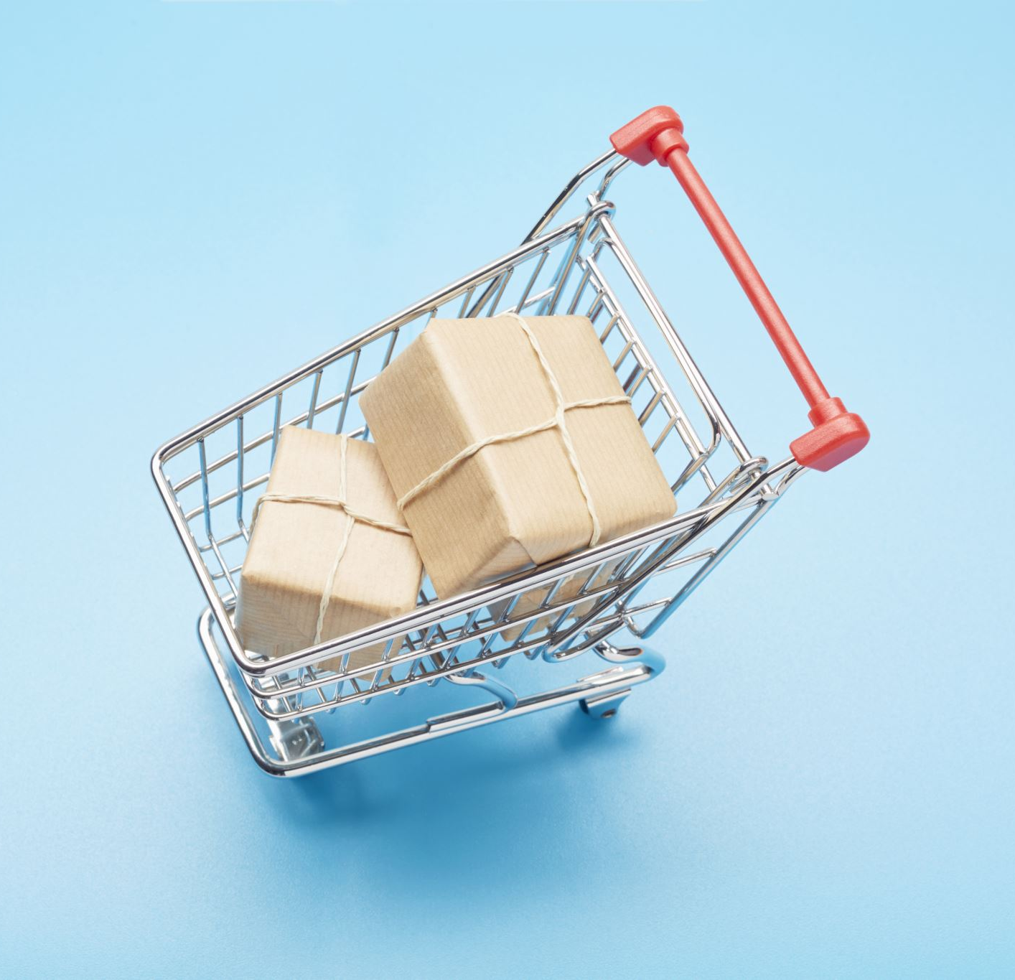
Market Basket Analysis
Algorithm Used :
Apriori - Association Algorithm

Slide 2

Problem Statement
G-Mart company wants to enhance the revenue generated from the sales of the products. The company wants to bundle the products and devise the sales strategies in such a manner that consumers spend more and buy the recommended products. The company needs an efficient recommender system which will help them group the products.

Slide 3
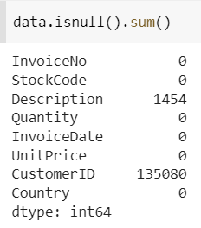
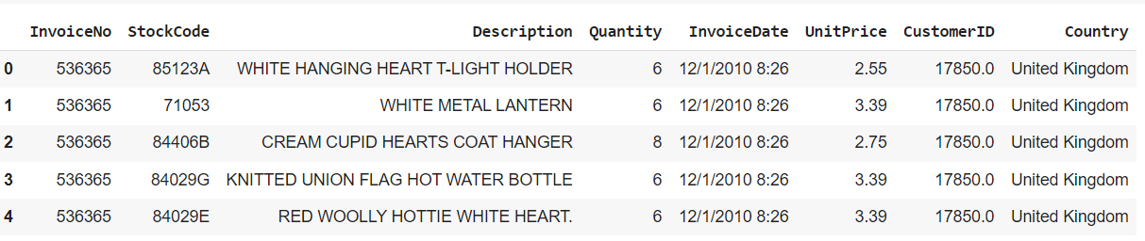

Insights from Data
Approximately 5.5 Lakhs transactions carried out
9,853 unique customers
About 5,000 products
51,76,450 Lakh quantities sold

Slide 4
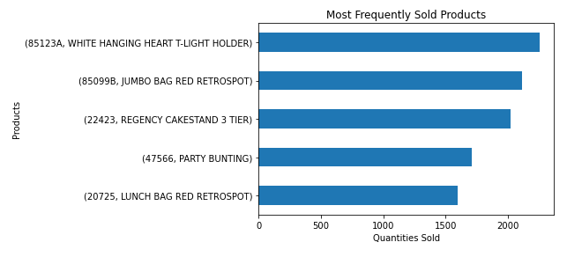
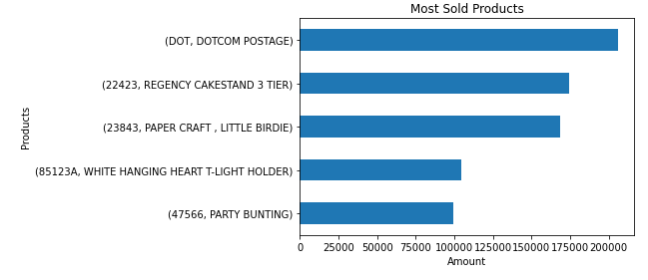
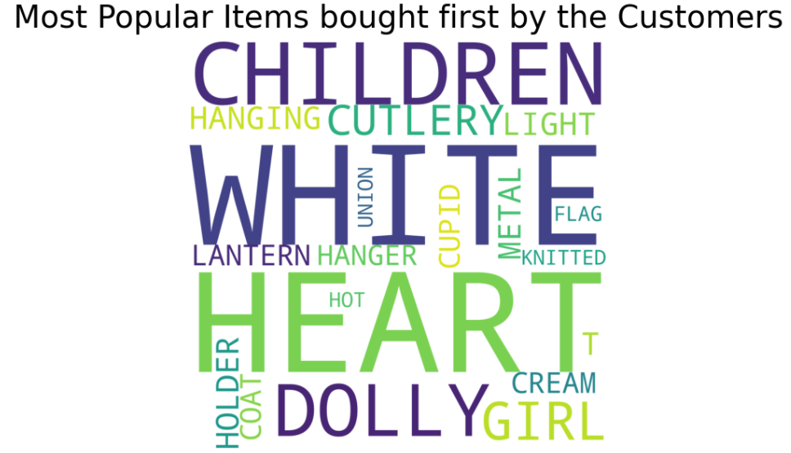
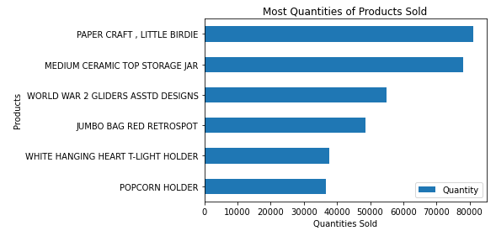

Slide 5
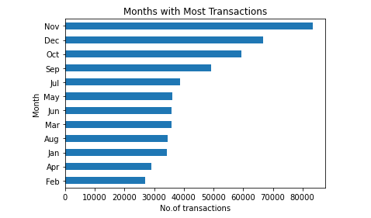
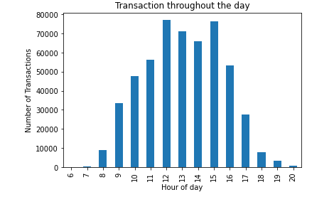
Overview of Transactions

Slide 6
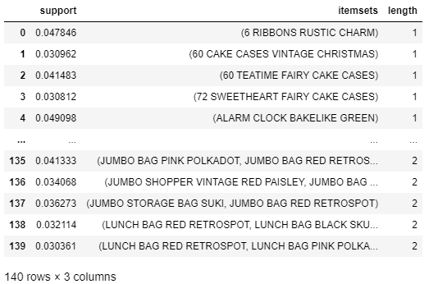
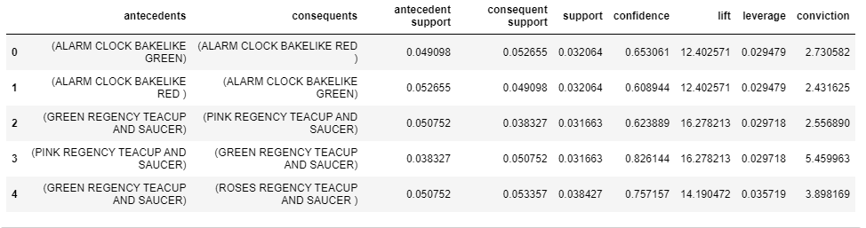
Apriori Model Building

Slide 7
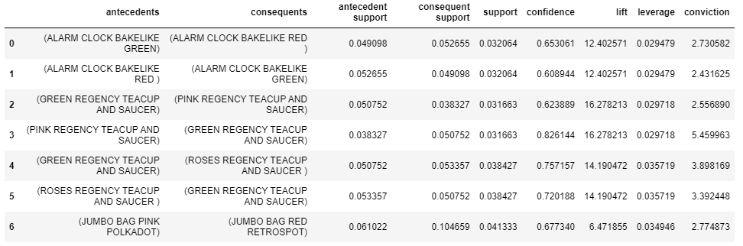
Rules
The results were filtered to show items that can bought together which have more than 6 lift and confidence of 0.6

Slide 8
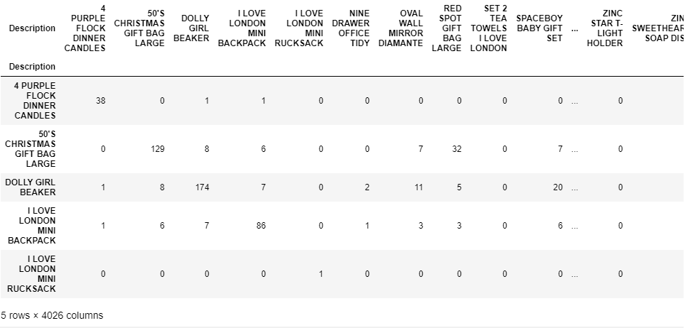
Co-occurrence Matrix
To find out the popular items are bought together we need to first create a matrix of Invoice ID and Description. Multiplying the matrix with its transpose would yield the co-occurrence matrix.
Finding the max values of the Co-occurrence matrix would tell us which items are usually bought together.

Slide 9
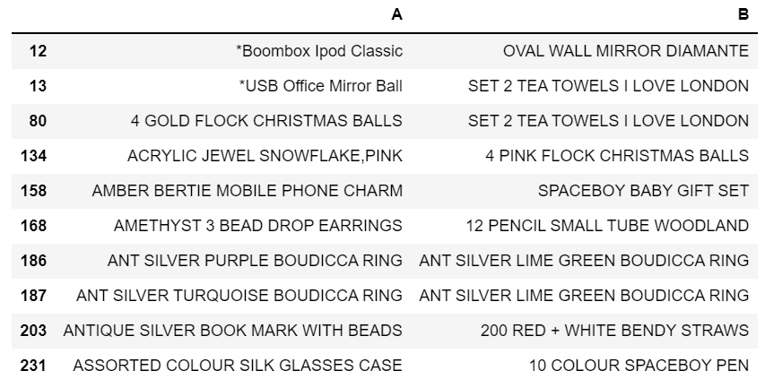
Highest value in Co-occurrence matrix corresponds to the most frequently bought products together by consumers.

Slide 10
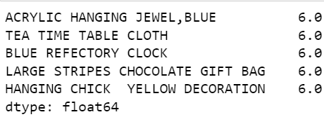
Recommender - Product Based Filtering
The 'WHITE HANGING HEART T-LIGHT HOLDER' is selected, and a correlation matrix is created for the same.
To make our recommendation more accurate and user specific we choose a customer from the dataset, to identify what the consumer has bought and check which products are the closest to the ones that have been bought using the correlation matrix and give our final recommendations.

Slide 11
Conclusion
Different aspects were explored that helped the company to make deductions about the store to understand the busiest hours and months for the store. Also, the net sales, most quantities sold, and top five most frequently sold products were visualized.
Market Basket Analysis was performed using association analysis which enabled company to understand which products are brought together using support, confidence and lift metrics.
This analysis helped the company to recommend at least 5 products to consumers based on his inclination to buy a desired product
Thus, the Recommender - Product Based Filtering is the solution for the company to group the products and devise the sales strategies to boast the sales revenue.

Slide 12
Thank you!

